Slide 1
Decision Trees
Y.LAKHMI PRASAD
08978784848

Slide 2
Objectives
What is Classification
Parametric Vs Nonparametric Models
Introduction to Decision Trees
Decision Tree Terminology
Building Decision Trees
Purity measures of Decision Trees
Different decision Tree Algorithms

Slide 3
What is Classification?
PARTITIONING the (FEATURE) SPACE into PURE REGIONS assigned to each CLASS

Slide 4
Parametric Vs Non- Parametric Models
A parametric model is Learning a fixed Number of parameters.
In Linear Regression, If we given 1 feature to the model, we are sure that the model is learning 2 parameters i.e., intercept and slope.
Whereas a non parametric model may learn more or less number of parameters based on the given data. Examples: KNN, Decision Tree, SVM with Kernels

Slide 5
Examples for Parametric Models
Linear Regression
Logistic Regression
Linear Discriminant Analysis
NaiveBayes
Linear SVM
Simple Neural Networks

Slide 6
Benefits of Parametric ML Algorithms
Simpler: These methods are easier to understand and interpret results.
Speed: Parametric models are very fast to learn from data.
Less Data: They do not require as much training data and can work well even if the fit to the data is not perfect.

Slide 7
Limitations of Parametric ML Algorithms
Constrained: By choosing a functional form these methods are highly constrained to the specified form.
Limited Complexity: The methods are more suited to simpler problems.
Poor Fit: In practice the methods are unlikely to match the underlying mapping function.

Slide 8
Examples for Non-Parametric Models
k-Nearest Neighbors
Decision Trees like CART and C4.5
Support Vector Machines with Kernels

Slide 9
Benefits Nonparametric ML Algorithms
Flexibility: Capable of fitting a large number of functional forms.
Power: No assumptions (or weak assumptions) about the underlying function.
Performance: Can result in higher performance models for prediction.

Slide 10
Limitations of Nonparametric ML Algorithms
More data: Require a lot more training data to estimate the mapping function.
Slower: A lot slower to train as they often have far more parameters to train.
Over-fitting: More of a risk to overfit the training data and it is harder to explain why specific predictions are made.

Slide 11
Decision Tree- Terminology
1. A decision tree uses a tree structure to specify sequences of decisions and consequences.
2. The input values of a decision tree can be categorical or continuous.
3. A decision tree employs a structure of nodes and branches, represent the decision being made. A decision node has two or more branches.
4. The topmost decision node in a tree which corresponds to the best predictor called root node.
5. A node without further branches is called a leaf node. The leaf nodes represent the final decisions.

Slide 12
Decision Tree- Types
1. Decision trees have two varieties: classification trees and regression trees.
2. Classification trees usually apply to output variables that are categorical such as yes or no, purchase or not purchase, and so on.
3. Regression trees, can apply to output variables that are numeric or continuous, such as the predicted price of a consumer good or the likelihood a subscription will be purchased.

Slide 13
Data Pre-process
1. Re-code multi-category targets into a 1-of-N scheme - make each binary
2. Convert dates and time data into a computable form
3. Avoid information loss
4. Define the target Variable.
5. Identify the Predictor Variables.
6. Understand correctly the missing value.
7. Partition data into train and validation datasets.

Slide 14
How to create Decision trees
1. Find the Split: Identify all possible split options, Choose the best split.
2. Grow the tree: Continue growing the tree till it meets a criterion. Grow the tree large and prune it.
3.Prune the tree: Create candidate sub-trees. Identify best candidate.
4. Extract Rules: Generate rule set corresponding to the tree, simplify the rules.

Slide 15
Decision Tree steps
1. Bring the data into your environment
2. Understand the data
3. Choose the algorithm, model
4. Build Basic model
5. Choose the Purity metric
6. Choose the Hyper parameters
7. Choose you features (Complexity)
8. Perform Feature engineering
9. Rebuild the Model

Slide 16
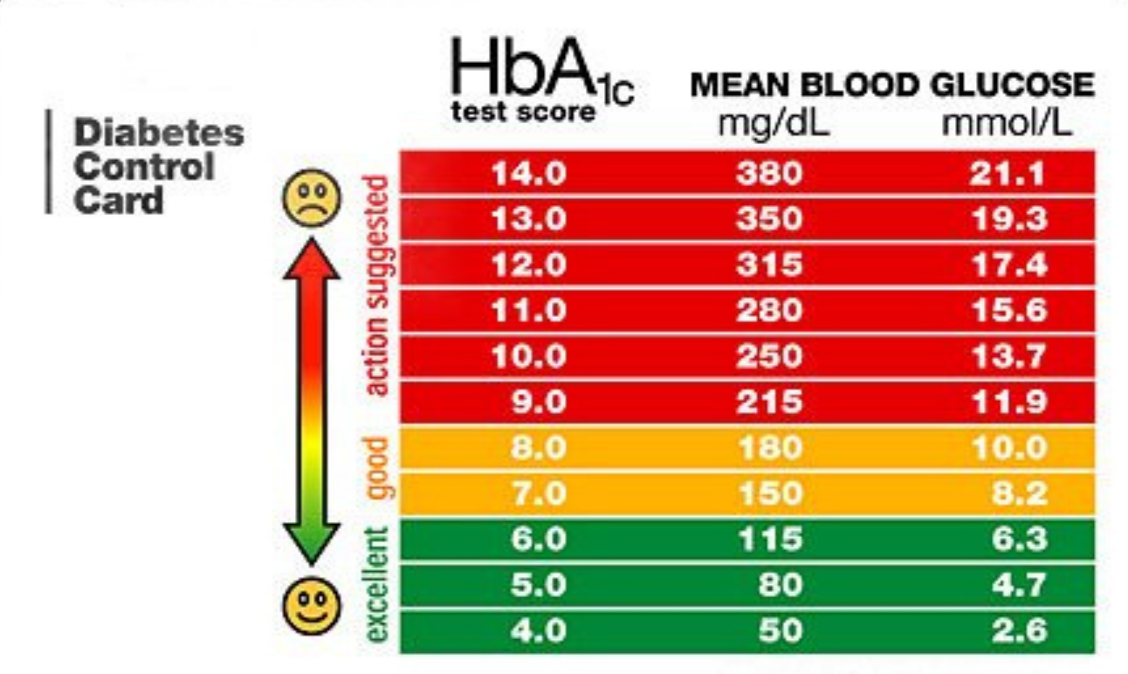
Domain Knowledge based
Fever Rules
If TEMP = 98.6 → NORMAL
If TEMP <= 100.0 → MILD-FEVER
If TEMP < 103.0 → MEDIUM-FEVER
If TEMP > 103.0 → HIGH-FEVER

Slide 17
“Toy” Dataset
Consider a dataset of toys given by three attributes:
COLOR = {Red, Green, Blue},
SHAPE = {Square, Circle, Triangle}, and
LIKE = {Yes, No} of whether a kid likes the toy or not.
#EXAMPLES | COLOR | SHAPE | LIKE = Y | LIKE = N
30 | Red | Square | 15 | 15
10 | Red | Circle | 0 | 10
20 | Red | Triangle | 15 | 5
10 | Green | Square | 10 | 0
30 | Green | Circle | 20 | 10
10 | Green | Triangle | 5 | 5
20 | Blue | Square | 5 | 15
20 | Blue | Circle | 15 | 5
30 | Blue | Triangle | 30 | 0

Slide 18
Joint and Marginal Probability
 |  | COLOR
 |  | Red | Blue | Green | TOTAL
SHAPE | Circle | 10 | 20 | 30 | 60
 | Square | 30 | 20 | 10 | 60
 | Triangle | 20 | 30 | 10 | 60
 | TOTAL | 60 | 70 | 50 | 180

Slide 19
Conditional Probability
 |  | COLOR
 |  | Red | Blue | Green | TOTAL
SHAPE | Circle | 10 | 20 | 30 | 60
 | Square | 30 | 20 | 10 | 60
 | Triangle | 20 | 30 | 10 | 60
 | TOTAL | 60 | 70 | 50 | 180
70
20
60
COLOR = Blue
SHAPE = Square

Slide 20
Conditional Probability Distribution
 |  | COLOR
 |  | Red | Blue | Green | TOTAL
SHAPE | Circle | 10 | 20 | 30 | 60
 | Square | 30 | 20 | 10 | 60
 | Triangle | 20 | 30 | 10 | 60
 | TOTAL | 60 | 70 | 50 | 180

Slide 21
Class distribution of a region!
 |  | COLOR
 |  | Red | Blue | Green | TOTAL
SHAPE | Circle | 0 / 10 | 15 / 5 | 20 / 10 | 60
 | Square | 15 / 15 | 5 / 15 | 10 / 0 | 60
 | Triangle | 15 / 5 | 30 / 0 | 5 / 5 | 60
 | TOTAL | 60 | 70 | 50 | 180

Slide 22
Metrics for Decision Trees
Accuracy
Entropy
GINI coefficient
Chi-Square
Reduction in Variance

Slide 23
Purity of a Region! (Accuracy)
ACCURACY
10 | 10
0.5 | 0.5
LOW
50%
100 | 100
0.5 | 0.5
LOW
50%
100 | 50
0.67 | 0.33
MEDIUM
67%
50 | 100
0.33 | 0.67
MEDIUM
67%
100 | 10
0.91 | 0.09
HIGH
91%
100 | 0
1.00 | 0.00
PERFECT
100%

Slide 24
Partition this!
 | Red | Blue | Green | TOTAL
Circle | 0 / 10 | 5 / 20 | 0 / 30 | 5 / 60
Square | 15 / 15 | 10 / 15 | 15 / 10 | 40 / 40
Triangle | 20 / 5 | 30 / 0 | 10 / 5 | 60 / 10
TOTAL | 35 / 30 | 45 / 35 | 25 / 45 | 105 / 110
R(?, ?)
105 / 110
R(Cir, ?)
5 / 60
R(Sqr, ?)
40 / 40
R(Tri, ?)
60 / 10
R(?, ?)
105 / 110
Which is a “better” partition?
What is “purity” of a partition?
R(?, Red)
35 / 30
R(?, Blu)
45/ 35
R(?, Gre)
25/ 45

Slide 25
Purity = ACCURACY
R(Cir, ?)
5 / 60
R(Sqr, ?)
40 / 40
R(Tri, ?)
60 / 10
LABEL??
Accuracy = ??
Accuracy = ??
Accuracy = ??
LABEL??
R(?, Red)
35 / 30
R(?, Blu)
45/ 35
R(?, Gre)
25/ 45

Slide 26
Purity = ACCURACY
Each PARTITION has data points from EVERY class.
Size of the PARTITON = total number of data points in it.
Each PARTITION has a CLASS PROBABILTY DISTRIBUTION.
Each PARTITION is assigned its MAJORITY CLASS LABEL
ACCURACY = fraction of CORRECTLY labeled examples
ERROR = fraction of INCORRECTLY labeled examples

Slide 27
GINI Measure
It is often used as a gauge of economic inequality, measuring income distribution or, less commonly, wealth distribution among a population.
The coefficient ranges from 0 (or 0%) to 1 (or 100%), with 0 representing perfect equality and 1 representing perfect inequality.
Values over 1 are theoretically possible due to negative income or wealth.

Slide 28
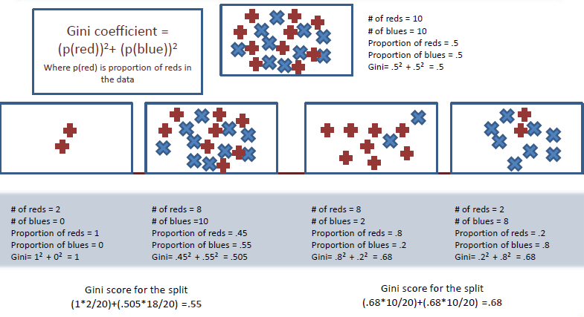
GINI Score

Slide 29
Purity = GINI Measure
In ACCURACY we assign the DOMINANT LABEL to each region
We now assign PROBABILISTIC LABEL to each region
R(Cir, ?)
5 / 60
R(Sqr, ?)
40 / 40
R(Tri, ?)
60 / 10
DOMINANT LABEL
5/65
40/80
60/70
PROBABILISTIC LABEL
60/65
40/80
10/70

Slide 30
Purity = GINI Measure
EXPECTED ACCURACY with PROBABISTIC LABELING
R(Cir, ?)
5 / 60
R(Sqr, ?)
40 / 40
R(Tri, ?)
60 / 10
5/65
40/80
60/70
PROBABILISTIC LABEL
60/65
40/80
10/70

Slide 31
Purity
GINI measures the EXPECTED ACCURACY of the PARTITION
ENTROPY is the INFORMATION CONTENT of the PARTITION

Slide 32
Entropy
A decision tree is built top-down from a root node and involves partitioning the data into subsets that contain instances with similar values (homogenous).
ID3 algorithm uses entropy to calculate the homogeneity of a sample.
If the sample is completely homogeneous the entropy is zero and if the sample is an equally divided it has entropy of one.

Slide 33
Purity of a Region! (1 – Entropy)
Purity
10 | 10
0.5 | 0.5
LOW
0.00
100 | 100
0.5 | 0.5
LOW
0.00
100 | 50
0.67 | 0.33
MEDIUM
0.50
50 | 100
0.33 | 0.67
MEDIUM
0.50
100 | 10
0.91 | 0.09
HIGH
0.90
100 | 0
1.00 | 0.00
PERFECT
1.00

Slide 34
Information Gain
The information gain is based on the decrease in entropy after a dataset is split on an attribute. Constructing a decision tree is all about finding attribute that returns the highest information gain (i.e., the most homogeneous branches).

Slide 35
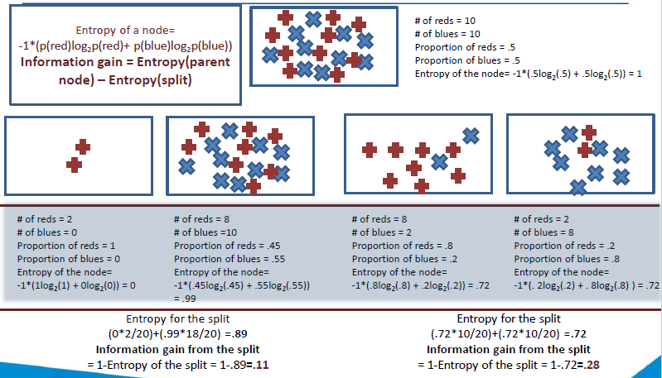
Information Gain

Slide 36
Chi-square Test
The chi-square test can be used to determine the association between categorical variables.
It is based on the difference between the expected frequencies (e) and the observed frequencies (n) in one or more categories in the frequency table.
The chi-square distribution returns a probability for the computed chi-square and the degree of freedom.
A probability of zero shows a complete dependency between two categorical variables and a probability of one means that two categorical variables are completely independent.

Slide 37
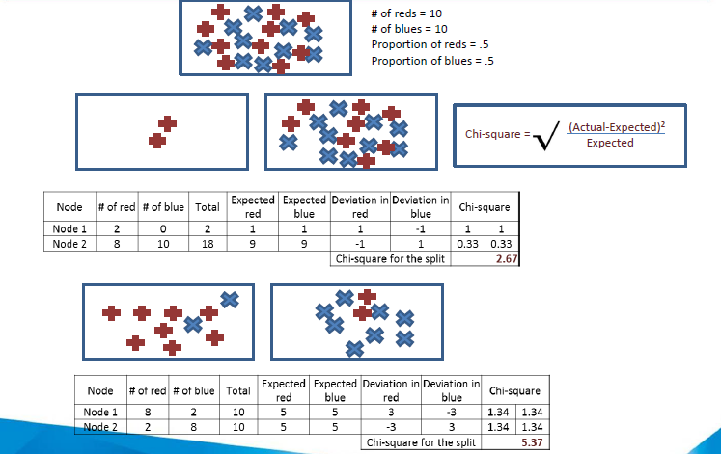
Chi-Square Score

Slide 38
Reduction in Variance
Variance reduction is often employed in cases where the target variable is continuous (regression tree), meaning that use of many other metrics would first require discretization before being applied.
The variance reduction of a node N is defined as the total reduction of the variance of the target variable, due to the split at this node

Slide 39
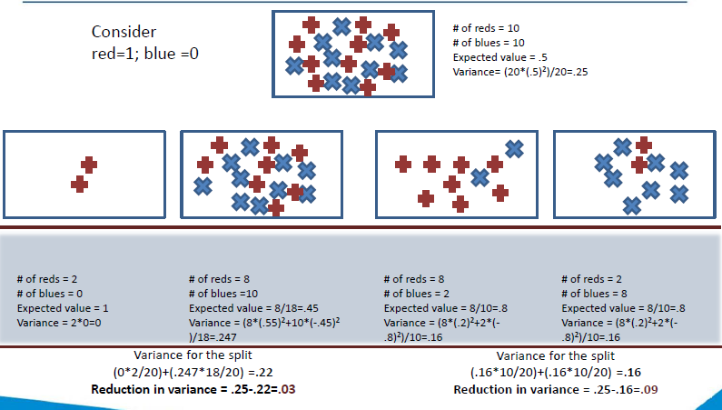
Reduction in Variance

Slide 40
Which feature to pick first?
R(?, ?)
105/ 110
R(Cir, ?)
5 / 60
R(Sqr, ?)
40 / 40
R(Tri, ?)
60 / 10
R(?, ?)
105 / 110
R(?, Red)
35 / 30
R(?, Blu)
45/ 35
R(?, Gre)
25/ 45

Slide 41
GREEDY Decision Tree Algorithm
A
a1
a2
a3
C
E
B
c1
c2
e1
e2
e3
b1
b2
b3
E
B
C
e1
e2
e3
b1
b2
b3
c1
c2

Slide 42
The “Right-Sized” Tree
Top-Down Stopping Rules (Pre-Pruning)
Node size
Tree depth
Statistical significance
Bottom-Up Selection Criteria (Post-Pruning)
Accuracy
Profit
Class-probability trees
Least squares

Slide 43
Decision Tree Algorithms
AID (Automatic Interaction Detection)
CHAID (CHi-squared AID)
CRT (or CART, Classification and Regression Trees)
ID3 (Iterative Dichotomizer 3)
C4.5,
C5.0

Slide 44
CHAID Algorithm
CHAID stands for CHi-squared Automatic Interaction Detector, is a type of decision tree technique, It is often used in the context of direct marketing to select groups of consumers and predict how their responses to some variables affect other variables.
Advantage: Its output is highly visual and easy to interpret.
Because it uses multi-way splits by default, it needs rather large sample sizes to work effectively, as with small sample sizes the respondent groups can quickly become too small for reliable analysis.

Slide 45
CHAID Algorithm
A chi-square test is a statistical hypothesis test where the test statistic is chi-squared distribution. This test is used to compare the interaction of independent variables with the dependent variable.

Slide 46
The CART approach
One of the decision tree algorithms is CART (Classification and Regression Tree)
The impurity (or purity) measure used in building decision tree in CART is Gini Index
The decision tree built by CART algorithm is always a binary decision tree (each node will have only two child nodes).
Gini Index: Only used when target variable is binary.

Slide 47
The CART approach
You are already familiar with CART, which creates a binary tree-a tree with a maximum of two child nodes for any node in the tree. Sometimes CART is not appropriate to visualise the important features in a dataset because binary trees tend to be much deeper and more complex than a non-binary tree- a tree which can have more than two child nodes for any node in the tree.

Slide 48
CART vs CHAID
This is where CHAID comes in. CHAID can create non-binary trees which tend to be shallower than the binary trees. This makes CHAID trees easier to look at and understand the important drivers (features) in a business problem. The process of finding out important features is also referred to as driver analysis.

Slide 49
CART vs CHAID
You looked at the different applications of CART and CHAID trees.
To put them in the form of an analogy, suppose you are working with the Indian cricket team, and you want to predict whether the team will win a particular tournament or not. In this case, CART would be more preferable because it is more suitable for prediction tasks.
Whereas, if you want to look at the factors that are going to influence the win/loss of the team, then a CHAID tree would be more preferable.

Slide 50
C4.5
Simple depth-first construction.
Uses Information Gain
Sorts Continuous Attributes at each node.
Needs entire data to fit in memory.
Unsuitable for Large Datasets.

Slide 51
C5.0
C5.0 offers a number of improvements on C4.5:
1. Speed - Significantly faster than C4.5
2. Memory Usage
3. Smaller Decision Trees
4. Support For Boosting
5. Weighting

Slide 52
OVERFITTING
A
a1
a2
a3
C
E
B
c1
c2
e1
e2
e3
b1
b2
b3
E
B
C
e1
e2
e3
b1
b2
b3
c1
c2

Slide 53
PRUNNING
A
a1
a2
a3
C
E
B
c1
c2
e1
e2
e3
b1
b2
b3
C
c1
c2

Slide 54
Questions for Classification!
What is the NATURE of classifier’s DECISION BOUNDARY?
What is the COMPLEXITY of classifier’s DECISION BOUNDARY?
How do I CONTROL the COMPLEXITY of the classifier?
How do I know when the classifier is COMPLEX ENOUGH?

Slide 55
Advantages of Decision tree
Easy to understand and Interpret
Able to handle both numerical and categorical data
Graphical representation aids visual understanding
Require less data preparation than other methods
Non parametric method
Result in form of rules.
Requires little data preparation. Other techniques often require data normalization. Since trees can handle qualitative predictors, there is no need to create dummy variables.
Deal well with outliers and missing values
Performs well with large datasets. Large amounts of data can be analysed using standard computing resources in reasonable time.
Combine well with other modelling techniques

Slide 56
Disadvantages
Tendency to over-fit, Decision-tree learners can create over-complex trees that do not generalize well from the training data.
Mechanisms such as pruning are necessary to avoid this problem.
Trees can be very non-robust. A small change in the training data can result in a large change in the tree and consequently the final predictions.
May results in too many splits on variables with many values.
For data including categorical variables with different numbers of levels, information gain in decision trees is biased in favour of attributes with more levels.

Slide 57
When to use decision tree?
Very popular classification technique especially when problem is binary
Best option when the interpretation of results is more important than the accuracy
Whenever available, use for initial data exploration in any project
Not the first choice for estimating continuous values

Slide 58
Questions?

